Slide 1
Matrix Algebra

Slide 2
Today’s Goals:
  Matrices, vectors, and scalars
  Basic matrix operations
  Linear combinations in matrix form

Slide 3
A matrix is a rectangular array of numbers with n rows and m columns. It is symbolized with a bold, upper case letter, and subscripted to indicate its order.
g₁₁ | g₁₂
g₂₁ | g₂₂
g₃₁ | g₃₂
G_{3,2}=
Rows
Columns

Slide 4
g₁₁ | g₁₂
g₂₁ | g₂₂
g₃₁ | g₃₂
G_{3,2}=
The individual elements in a matrix are called scalars, subscripted to indicated their position in the matrix.

Slide 5
g₁₁ | g₁₂
g₂₁ | g₂₂
g₃₁ | g₃₂
G_{3,2}=
The columns in a matrix are called vectors, and are symbolized with lower case, bold letters. This matrix has two vectors (g₁, g₂), each containing three scalars.

Slide 6
This vector is also a 3 x 1 matrix. When displayed as a row, it is symbolized differently:
g₁₁
g₂₁
g₃₁
g_{3,1}=
g′_{1,3}=
g₁₁ | g₂₁ | g₃₁
This is called the transpose of the vector.

Slide 7


The standard data matrix . . .
can be transposed . . .
to change the object of measurement and shift the focus of the analysis

Slide 8
This matrix is rectangular. When the number of rows and columns are equal, the matrix is square:
g₁₁ | g₁₂
g₂₁ | g₂₂
g₃₁ | g₃₂
G_{3,2}=
f₁₁ | f₁₂ | f₁₃
f₂₁ | f₂₂ | f₂₃
f₃₁ | f₃₂ | f₃₃
F_{3,3}=

Slide 9
Data matrices are typically rectangular; correlation matrices and covariance matrices are always square.
Square matrices have some additional useful properties.

Slide 10
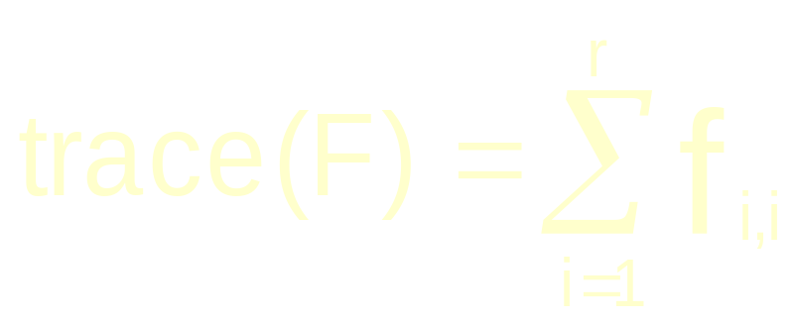
A square matrix has a main diagonal. The sum of the elements of the main diagonal is called the trace of the matrix.
f₁₁ | f₁₂ | f₁₃
f₂₁ | f₂₂ | f₂₃
f₃₁ | f₃₂ | f₃₃
F_{3,3}=
Notes:
The trace of residual covariance matrix can be useful; it contains information about how much residual variation is available for further analysis.

Slide 11
If f_{i,j} = f_{j,i} for all i and j, the matrix is symmetric.
1 | 3 | -4
3 | 11 | 7
-4 | 7 | 2
F_{3,3}=
F is a symmetric matrix with a trace of 14. Correlation matrices and covariance matrices are symmetric.

Slide 12
If all elements of a symmetric matrix except the main diagonal are zero, the matrix is a diagonal matrix:
1 | 0 | 0
0 | 11 | 0
0 | 0 | 2
F_{3,3}=
F is a symmetric, diagonal matrix with a trace of 14.
Notes:
A diagonal matrix is useful for transformations and occasionally as a target matrix in statistics.

Slide 13
Matrix Addition and Subtraction:
  Matrices of the same order can be added and subtracted.
  These operations take place element by element.

Slide 14
1 | 3
3 | 11
-4 | 7
4 | -1
6 | 2
12 | 8
F_{3,2}=
H_{3,2}=
1+4 | 3+(-1)
3+6 | 11+2
-4+12 | 7+8
5 | 2
9 | 13
8 | 15
F + H = K_{3,2} =
=

Slide 15
1 | 3
3 | 11
-4 | 7
4 | -1
6 | 2
12 | 8
F_{3,2}=
H_{3,2}=
1-4 | 3-(-1)
3-6 | 11-2
-4-12 | 7-8
-3 | 4
-3 | 9
-16 | -1
F - H = K_{3,2} =
=

Slide 16
Matrix addition is commutative and associative:
A + B = B + A
A + B + C = (A + B) + C = A + (B + C)
Matrix subtraction is distributive:
A – (B + C) = A – B – C
A – (B – C) = A – B + C

Slide 17
A matrix of zeros is called a zero matrix or a null matrix. It is used in solving equations:
5 | 7
4 | 2
6 | 1
y₁₁ | y₁₂
y₂₁ | y₂₂
y₃₁ | y₃₂
7 | -1
7 | 4
8 | 3
+
=
X Y Z

Slide 18
5 | 7
4 | 2
6 | 1
y₁₁ | y₁₂
y₂₁ | y₂₂
y₃₁ | y₃₂
7 | -1
7 | 4
8 | 3
+
=
X Y Z
-5 | -7
-4 | -2
-6 | -1
5 | 7
4 | 2
6 | 1
y₁₁ | y₁₂
y₂₁ | y₂₂
y₃₁ | y₃₂
-5 | -7
-4 | -2
-6 | -1
7 | -1
7 | 4
8 | 3
+
+
=
+
-X X Y -X Z

Slide 19
-5 | -7
-4 | -2
-6 | -1
5 | 7
4 | 2
6 | 1
y₁₁ | y₁₂
y₂₁ | y₂₂
y₃₁ | y₃₂
-5 | -7
-4 | -2
-6 | -1
7 | -1
7 | 4
8 | 3
+
+
=
+
0 | 0
0 | 0
0 | 0
y₁₁ | y₁₂
y₂₁ | y₂₂
y₃₁ | y₃₂
2 | -8
3 | 2
2 | 2
+
=

Slide 20
Scalar multiplication is accomplished by multiplying every element of a matrix by a constant scalar:
1 | 3 | -4
3 | 11 | 7
-4 | 7 | 2
F_{3,3}=
k= 5
5 x 1 | 5 x 3 | 5 x -4
5 x 3 | 5 x11 | 5 x 7
5 x -4 | 5 x 7 | 5 x 2
kF =

Slide 21
Matrix multiplication requires attending to a few important rules:
The order of multiplication is important.
Matrices can only be multiplied if the number of columns of the first matrix is equal to the number of rows of the second matrix.
The resulting matrix has an order equal to the number of rows of the first matrix and the number of columns of the second matrix.

Slide 22
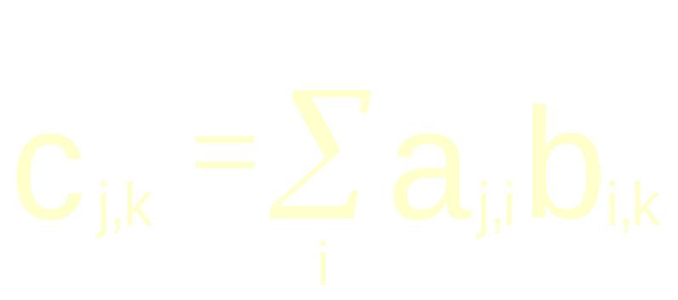
These two must be the same.
A_{ji} B_{ik} = C_{jk}
The elements of C are defined as:

Slide 23
4 | -1
7 | 0
6 | 2
1 | 7 | 0
4 | 2 | 6
0 | 26 | -6
7 | 49 | 0
14 | 46 | 12
=
A_{3,2}
B_{2,3}
C_{3,3}
(4 x 1) + (-1 x 4) = 0
(6 x 0) + (2 x 6) = 12

Slide 24
Matrix multiplication is not commutative:
It may not be possible:
A_{2,3}B_{3,5} = C_{2,5} but B_{3,5}A_{2,3} is impossible
When possible, the results may not be equal: A_{1,3}B_{3,1} = C_{1,1} but B_{3,1}A_{1,3} = C_{3,3}
=
≠
≠

Slide 25
Matrix multiplication is associative:
ABC = (AB)C = A(BC)
Matrix multiplication is distributive:
A(B+C) = AB + AC
But order is important:
XA + BX ≠ X(A + B)

Slide 26
Every matrix has a transpose that is obtained by exchanging the rows and columns:
4 | -1
7 | 0
6 | 2
4 | 7 | 6
-1 | 0 | 2
X′
(or X^{T})
X

Slide 27
Transposes are useful for arranging a matrix so that matrix multiplication is possible.
Example: A common statistical requirement is to generate the sums of squares and cross-products for a data matrix. If X_{n,v} is a matrix of deviation scores, then X_{nv}X_{nv} is not possible. But, X′_{vn}X_{nv} can be carried out.

Slide 28
Sum of deviation cross-products
d₁₁ | d₂₁ | d₃₁ | d₄₁ | d₅₁
d₁₂ | d₂₂ | d₃₂ | d₄₂ | d₅₂
d₁₁ | d₁₂
d₂₁ | d₂₂
d₃₁ | d₃₂
d₄₁ | d₄₂
d₅₁ | d₅₂
? | ?
? | ?
?
D´
=
D is a matrix of deviation scores for 5 individuals on 2 variables.
Sum of squared deviations
D

Slide 29
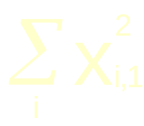
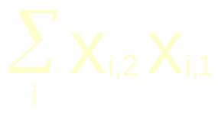
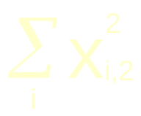
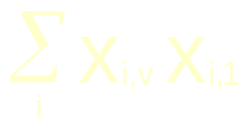
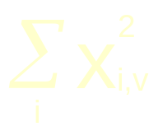
X_{nv} is a People x Variables matrix of deviation scores.
X′_{vn}X_{nv} =
This matrix is one step away from what other matrix?

Slide 30
The identity matrix is a diagonal matrix with ones on the main diagonal:
1 | 0 | 0 | 0
0 | 1 | 0 | 0
0 | 0 | 1 | 0
0 | 0 | 0 | 1
I =
The identity matrix is often a useful target matrix in statistics.

Slide 31
Multiplication by diagonal matrices is especially important in statistics and is used to accomplish rescaling (expanding, shrinking, standardizing).
Post-multiplication of a matrix X by a diagonal matrix D results in the columns of X being multiplied by the corresponding diagonal element in D.

Slide 32
4 | 7
7 | 6
3 | 0
0 | 2
12 | 14
21 | 12
X
D
Y
The first column of X is multiplied by the diagonal element in the first column of D
The second column of X is multiplied by the diagonal element in the second column of D

Slide 33
Pre-multiplication of a matrix X by a diagonal matrix D results in the rows of X being multiplied by the corresponding diagonal element in D.

Slide 34
3 | 0
0 | 2
4 | 7
7 | 6
12 | 21
14 | 12
=
D
X
Y
The first row of X is multiplied by the diagonal element in the first row of D
The second row of X is multiplied by the diagonal element in the second row of D

Slide 35
Scalar multiplication is just multiplication by a diagonal matrix with a constant in the diagonal.
3 | 0
0 | 3
4 | 7
7 | 6
12 | 21
21 | 18
=
4 | 7
7 | 6
3 | 0
0 | 3
12 | 21
21 | 18
=

Slide 36
Variance-covariance matrices and correlation matrices can be characterized by a single number called the determinant that represents the “generalized variance.”
For the correlation matrix, this number can take on values from 0 to 1. When all variables are independent (an identity matrix), the determinant is 1. As variables increase in their interdependence, the determinant approaches 0. A singular matrix has a determinant of 0.
The determinant thus indexes the redundancy among variables in a correlation matrix.

Slide 37
The determinant of the matrix, A, is symbolized:
| A |
The determinant of an identity matrix, | I |, equals 1.

Slide 38
Some square matrices have an inverse such that AA⁻¹ = I. The inverse is useful in solving matrix equations:
Y = BR
Solving for B:
YR⁻¹ = BRR⁻¹
YR⁻¹ = B
This is equal to an identity matrix and so drops out.

Slide 39
X_{10,20} = (Z_{10,5} + B_{10,5}) A_{5,20}
solve for B:
X_{10,20} = Z_{10,5}A_{5,20} + B_{10,5}A_{5,20}
X_{10,20} - Z_{10,5}A_{5,20} = B_{10,5}A_{5,20}
(X_{10,20} - Z_{10,5}A_{5,20})A´_{20,5} = B_{10,5}A_{5,20}A´_{20,5}
(X_{10,20} - Z_{10,5}A_{5,20})A´_{20,5}(A_{5,20}A´_{20,5})⁻¹ =
B_{10,5}(A_{5,20}A´_{20,5})(A_{5,20}A´_{20,5})⁻¹
I

Slide 40
If I create the following linear combinations of the original variables:
X_{1,1} | X_{1,2} | X_{1,3}
X_{2,1} | X_{1,2} | X_{2,3}
X_{3,1} | X_{2,2} | X_{3,3}
. . . | . . . | . . .
X_{n,1} | X_{n,2} | X_{n,3}
1 | 1 | 1
1 | 0 | -2
1 | -1 | 1
= Y
W
What do the new variables represent? What are the variances and covariances of the new variables?
X

Slide 41
Everything we need to know about the variances and covariances of the linear combinations is contained in the variance-covariance matrix of the original variables (Σ).
V₁
V₂
V₃
V₁
σ²₁
σ₁₂
σ₁₃
Σ =
V₂
σ₂₁
σ²₂
σ₂₃
V₃
σ₃₁
σ₃₂
σ²₃
If Y = XW, then Σ_{y} = W’ Σ W

Slide 42
Another common set of transformations that will be made can be summarized as:
LXM
In which X is a Groups x Variables matrix of means, L is matrix of weights used to create linear combinations of groups (e.g., group contrasts), and M is a matrix of weights used to create linear combinations of variables.
By carefully constructing L and M, we can make any group comparisons for any combinations of variables.

Slide 43
Next time:
Univariate statistics and the use of L and M.

